Slide 1


Project presentation on “Hostel Management system” Sub- Project Paper code- Mca -CS-601
Submitted By
Anirban Ganguly Under The Guidance of
Roll- 90/MCA No- 190001 Prof. Priya Ranjan Sinha Mahapatra
Reg No- 100131 of 2019-2020
Sanket Auddya
Roll- 90/MCA No- 190010
Reg No- 100136 of 2019-2020
Dept. of Computer Science and Engineering
University of Kalyani

Slide 2
Acknowledgement
We would like to express a deep sense of thanks and gratitude to our project guide Prof. Priya Ranjan Sinha Mahapatra for guiding us immensely through the course of our project. His constructive advice and constant motivation have been responsible for the successful progression of our project.
My sincere thanks to all the teachers of our department for their motivation and support. We must thank our classmates for their timely help and support for completion of this project
Sanket Auddya
Date: 27/06/2022 Anirban Ganguly
MCA 6th SEM

Slide 3
Table Of Contents
Topic 1. Introduction Page No.
1) Introduction to the System 06
2) Problem Defination 07
3) Our Aim 07
4) Objective of our system 08
5) Need of System 08
Topic 2. Hardware and Software requirements
1) Software Requirements 09
2) Hardware Requirements 09

Slide 4
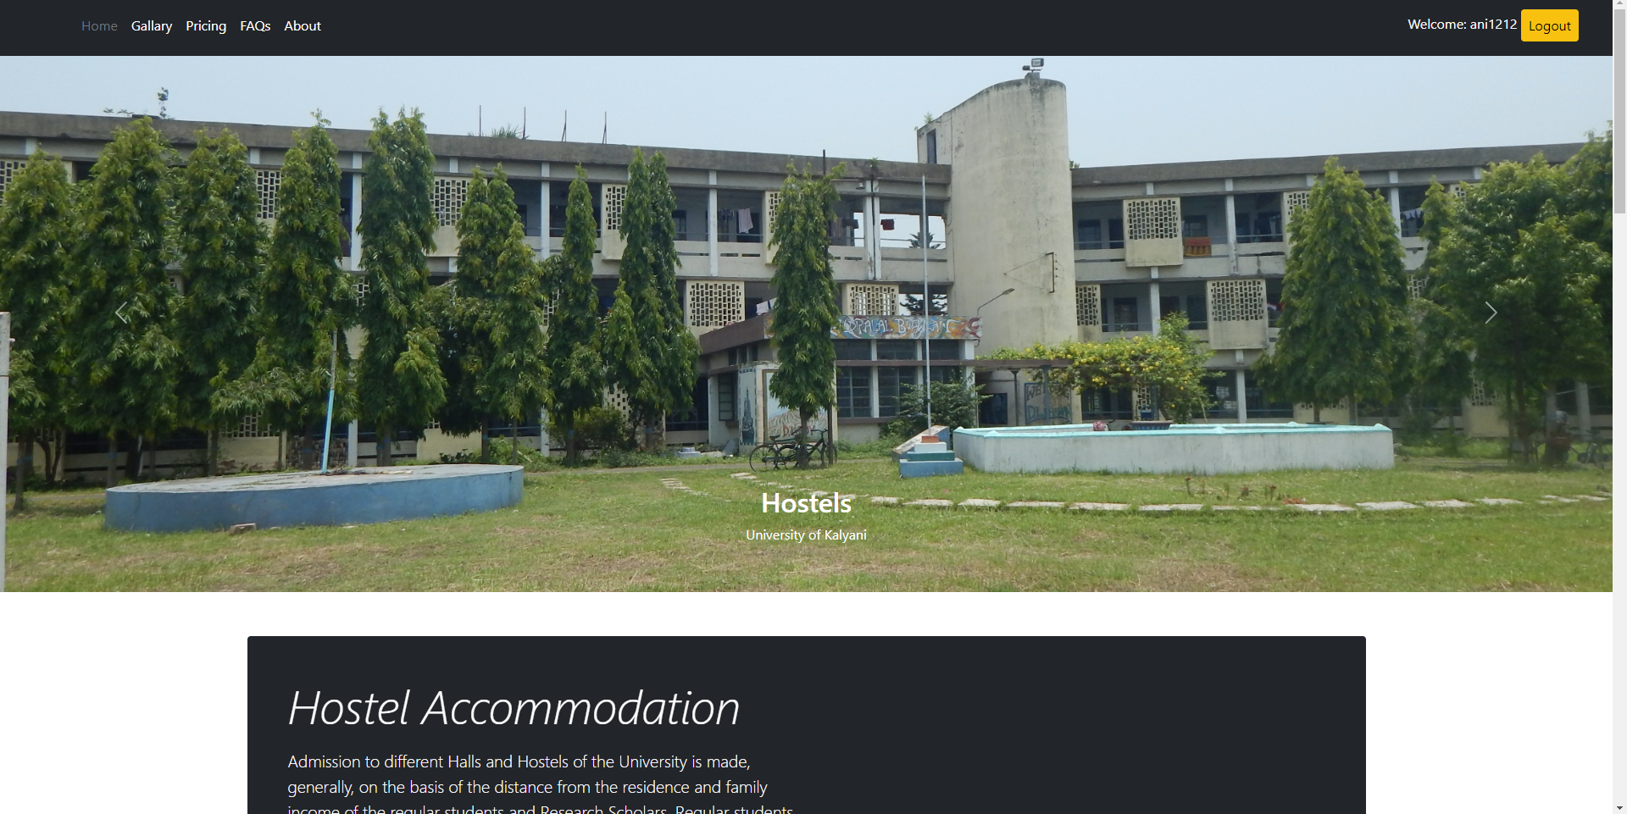

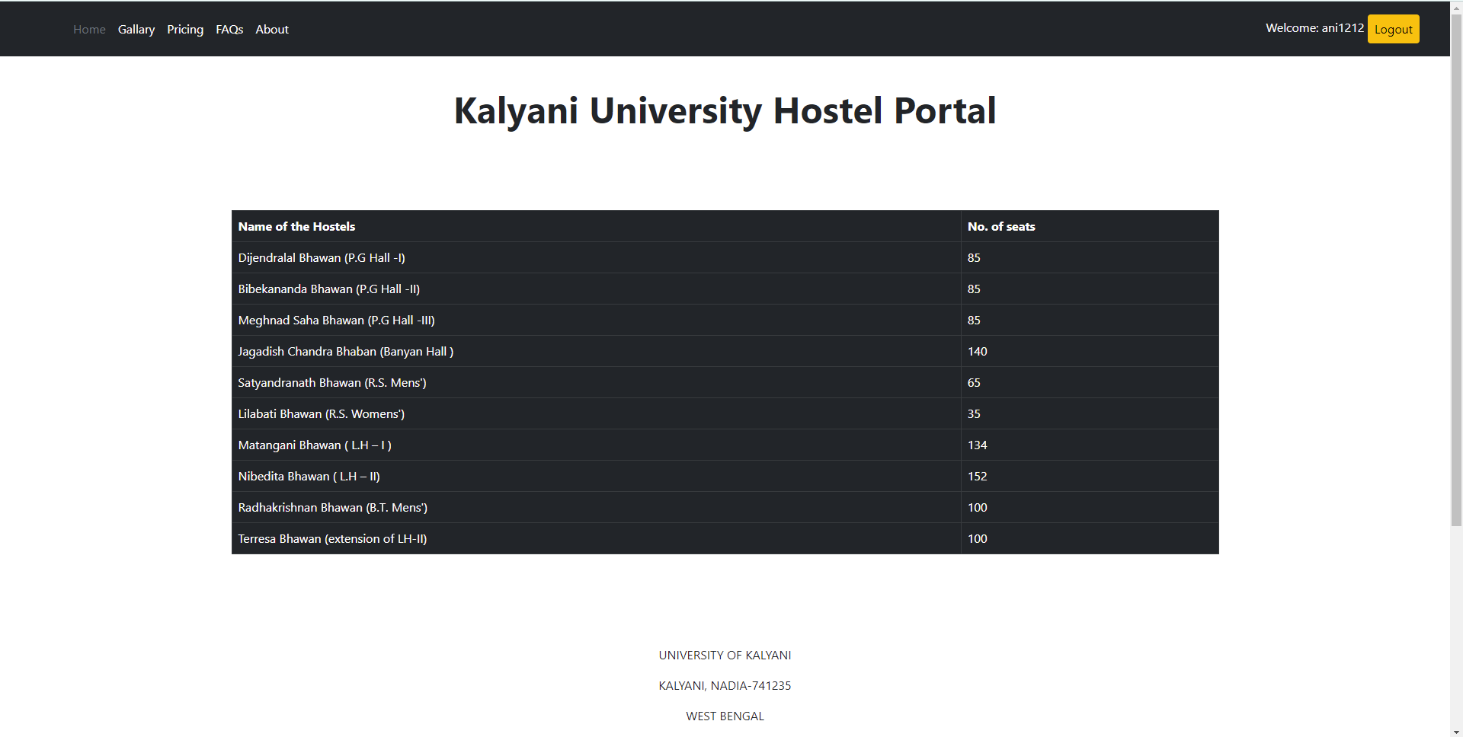
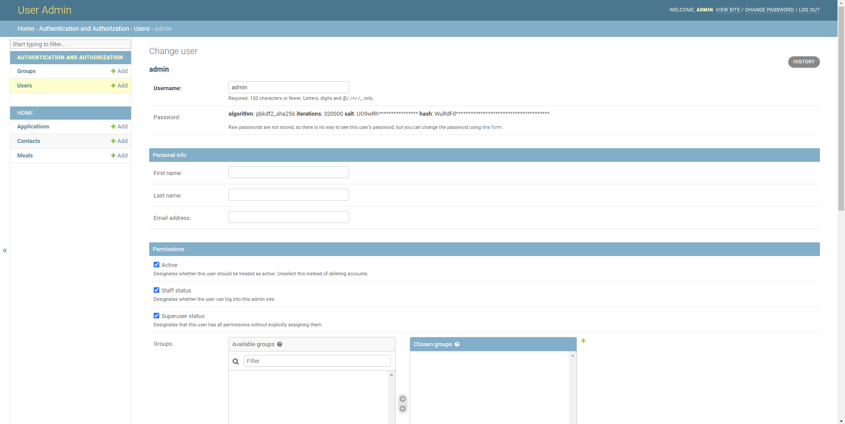
Topic 3. System Analysis
1) Purpose 01
2) Project Scope 10
3) Existing System 11
4) Proposed System 12
5) System Description 13
Topic 4. System Design
1) Module Description 14
2) ER Diagram 24
3) Data Flow Diagram(DFD) of the system 23
Topic 5. User Screen Snapshots

Slide 5
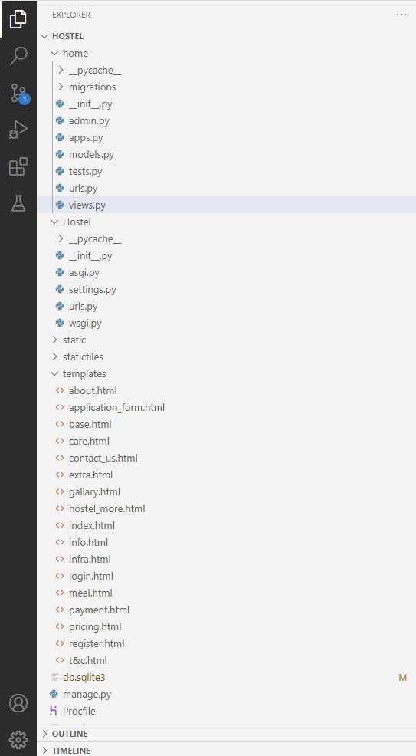
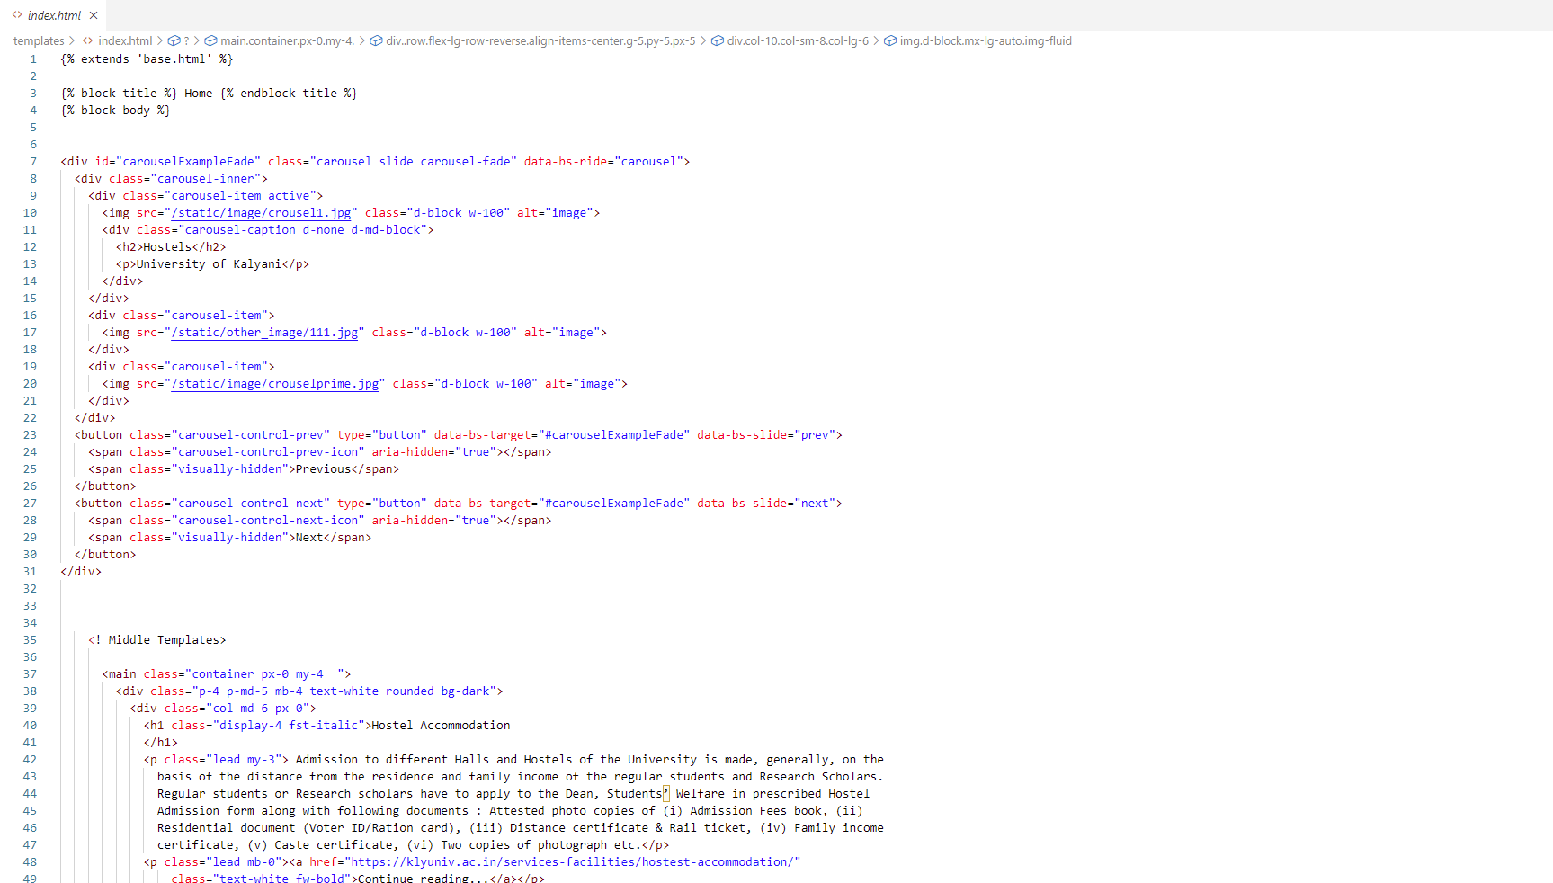
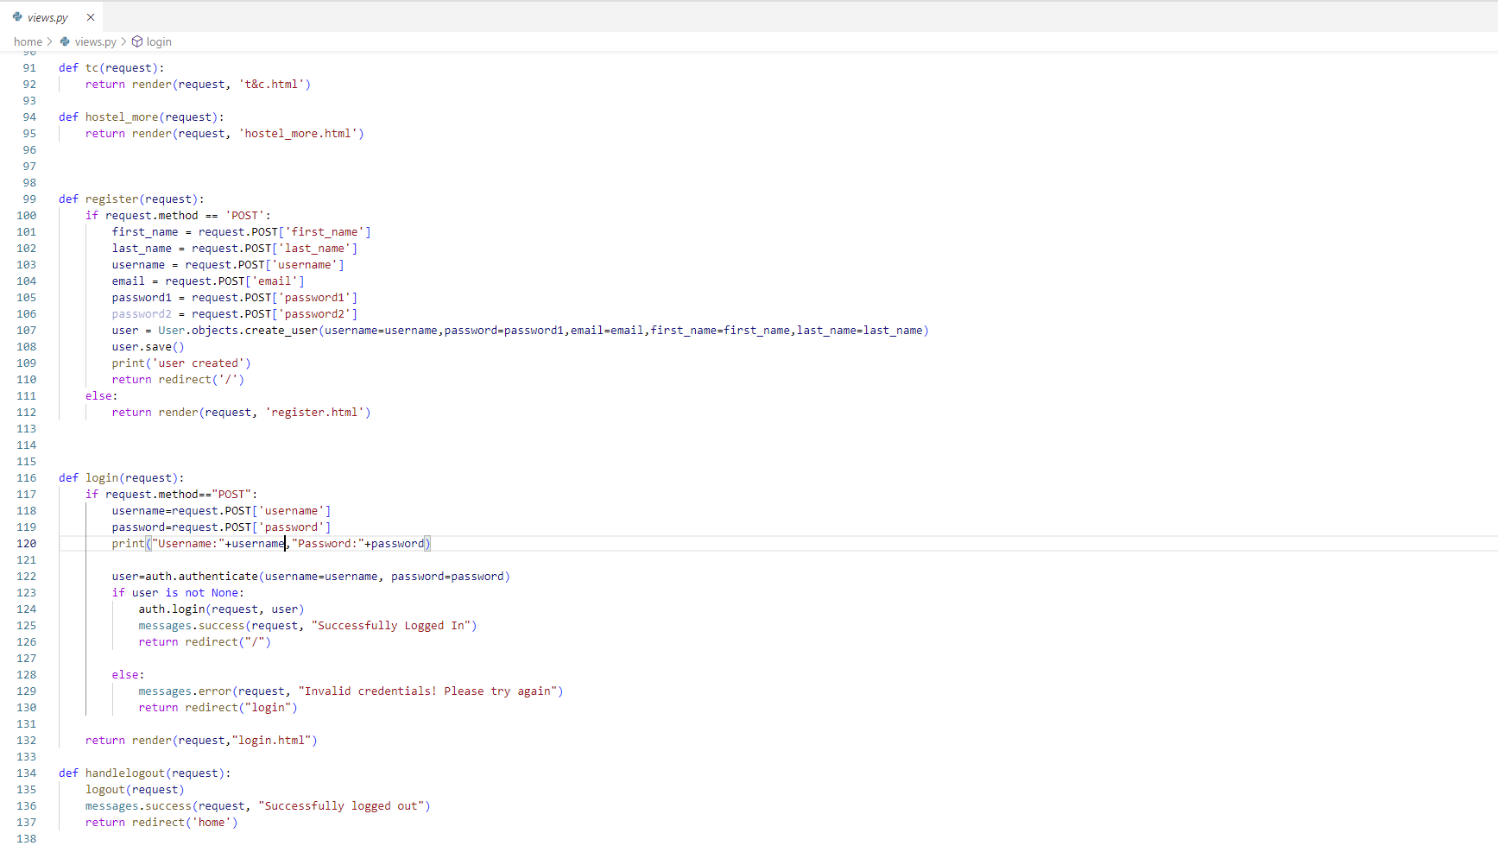
Topic 6: Coding
Topic 8: Bibliography
https://getbootstrap.com/docs/5.1/getting- started/introduction/
https://tailwindcss.com/
https://www.youtube.com/watch?v=JxzZxdht-XY&t=5383
https://aws.amazon.com/
http://54.87.131.9/
s

Slide 6
Introduction to the System
“Hostel Management System” is a web application developed for managing various activities in a hostel or a mess. For a past few years and in the recent days the number of educational institutions are increasing rapidly. Thereby the number of hostels or messes are also increasing for the accommodation of the students studying in the institute. In our country all the Colleges and Universities have their own hostels or messes. Very few hostels or messes have an online system to handle all its operations. And hence there is a lot of strain on the persons who are running the hostel and a lot of paper works had to be done everyday and software’s are not being used in this context. This particular project deals with the problems on managing a hostel and avoids the problems which occurs when carried manually.
Identification of the drawbacks of the existing systems leads to the designing of the computerized system that will be compatible to the existing system with the system which is more user friendly and more GUI oriented and decrease the overhead of the existing offline system.

Slide 7
Problem Definition
The system is designed in favor of the hostel management which helps them to save the records of its current borders about their room numbers and other things. It helps them from the manual work from which it will be difficult to find the record of the students and the mess bills of the students and their other personal information and the information of ex-students who had left the hostel. All the hostels are managed manually by the hostel office. The registration form verification to the different data processing is done manually. Thus there are a lot of repetitions which can be easily avoided. And hence there is a lot of strain on the person who are running the hostel and software’s are not used in this context. This particular project deals with the problems on managing a hostel and avoids the problems which occur when carried manually identification of the drawbacks of the existing system leads to the designing of computerized system that will be compatible to the existing system with the system which is more user friendly. We can improve the efficiency of the system, thus overcome the drawbacks of the existing system. We design this system of the hostel management especially for the University hostels, through this they cannot require so efficient person to handle and calculate the things. This system automatically calculates all the bills and issued the notification for those students who are against some rule.
Aim
To record all the student details, their monthly and annual charges, expanses of the hostels, monthly meal charge, applications of the students, information of hostel staffs.

Slide 8
Objective of the System
This web application is designed to improve the official works, and to reduce the manual work of the persons in the admin panel and the bundle of registers that were search when to find the information of a previous student become very hard. By this system we can retrieve the data of every present and previous students. The system will help you to check the mess bills of every student and the students hostel dues. The students of the hostel will be recognized from the ID number allocated at the room rental time. At last this system will improve the management work in the hostel.
To automate each and every activity of the manual system, which increases its throughput.
To provide a quick response with very accurate information as and when required.
To make the present manual system more interactive, speedy and user friendly.
To avail any information whatever and whenever needed.
Reduce the paper works manually.
Need of the System
There is always a need of a system that will perform management of hostel and student records with their fees. This system will reduce the manual operations required to maintain all records and also generates various reports for analysis

Slide 9
Purpose
To manage the hostel allotment of the students. It also helps to manage student room rent and employees' payments. This project also helps in administrative work such as keep information of students and rooms.
Project Scope
The project has a wide scope as it is not intended to a particular organization. This project is going to develop generic software, which can be applied by any hostel business organization. More over it provides facility to its users. Also the software is going to provide a huge amount of summary data.

Slide 10

FRONT END

Slide 11
Existing System
Requires a lot of time as well as manpower to manage register system . It is very difficult to maintain or update all the record and retrieve certain data.
In the existing system applying for the there were many problems faced by the students like standing in the queues, waiting for longer hours because of manual entry.
The Existing system is a manually maintained system. So the need for the automation is necessary.
All these details are entered and retrieved manually which is time consuming updating process inaccuracy of data.
Bills of all the expanses, meal charges, dues has to be recorded each day manually by a manager. Distribution of meal charges, room charge, electricity charges among the students is done manually.
Proposed System
To replace the existing system which is much time consuming.
To provide quick and efficient means for gathering the students information along with their rooms, fees of students and finally the check in and checkout time, every days meal count etc.
The data has been organized according to the time and student details. Risk of losing data is minimal and easy to update the data. A backup can be easily generated.

Slide 12
System Description
Hostel Management System is a web application which aims at the computerization of hostel management letting the entire process and its management be done using in computer.
This website has been designed in such a way that it helps both students as well as the admin.
It can be accessed completely by both students and admin regarding the rooms allotment, mess and much more.

Slide 13
Front End

Slide 14
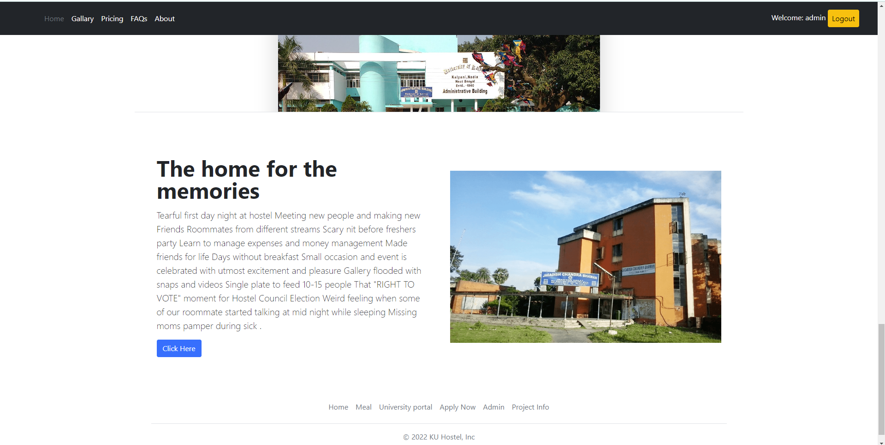
Front End

Slide 15
Front End

Slide 16
Front End

Slide 17
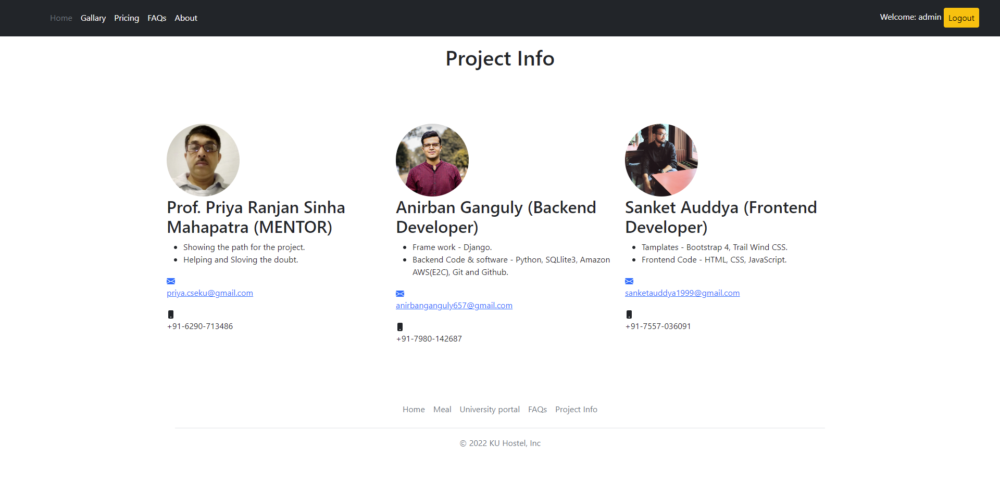
Front End

Slide 18
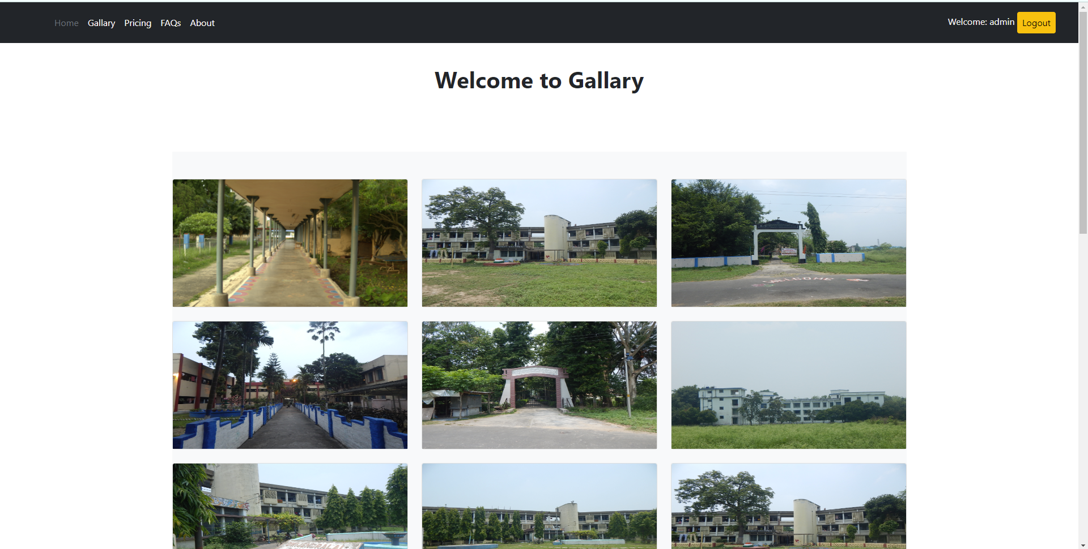
Front End

Slide 19
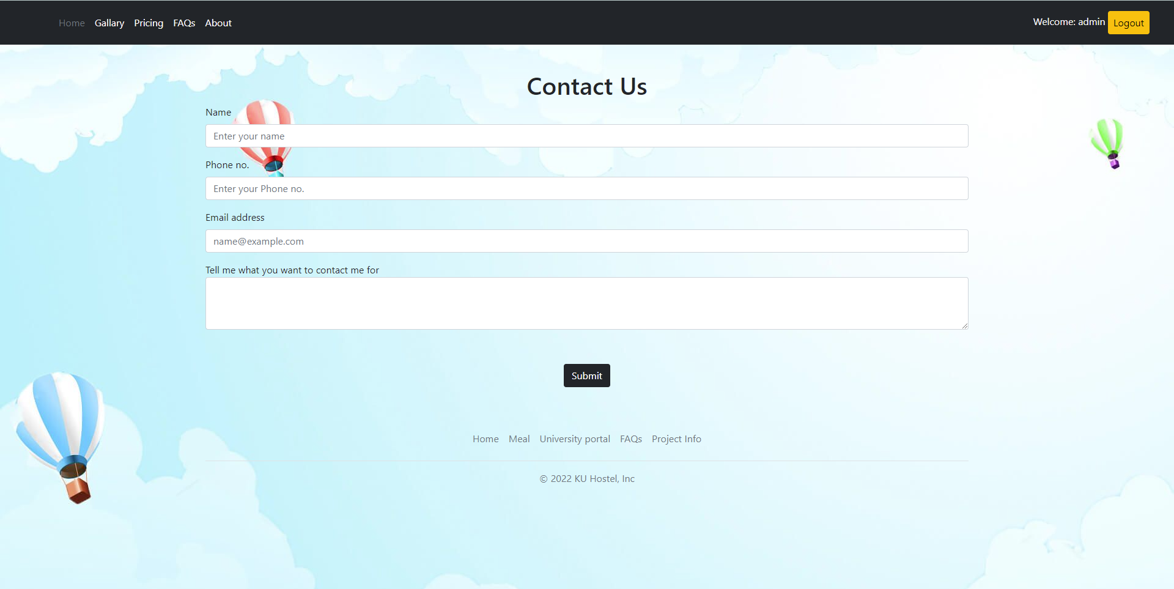
Front End

Slide 20
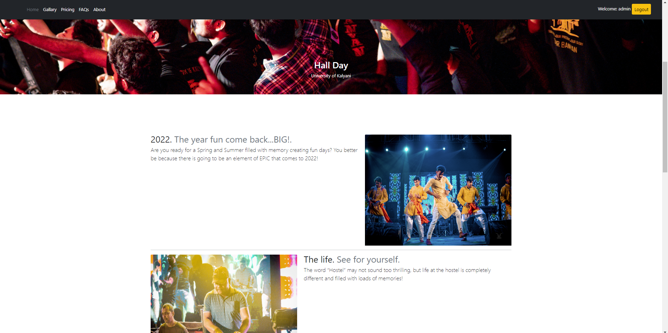
Front End

Slide 21
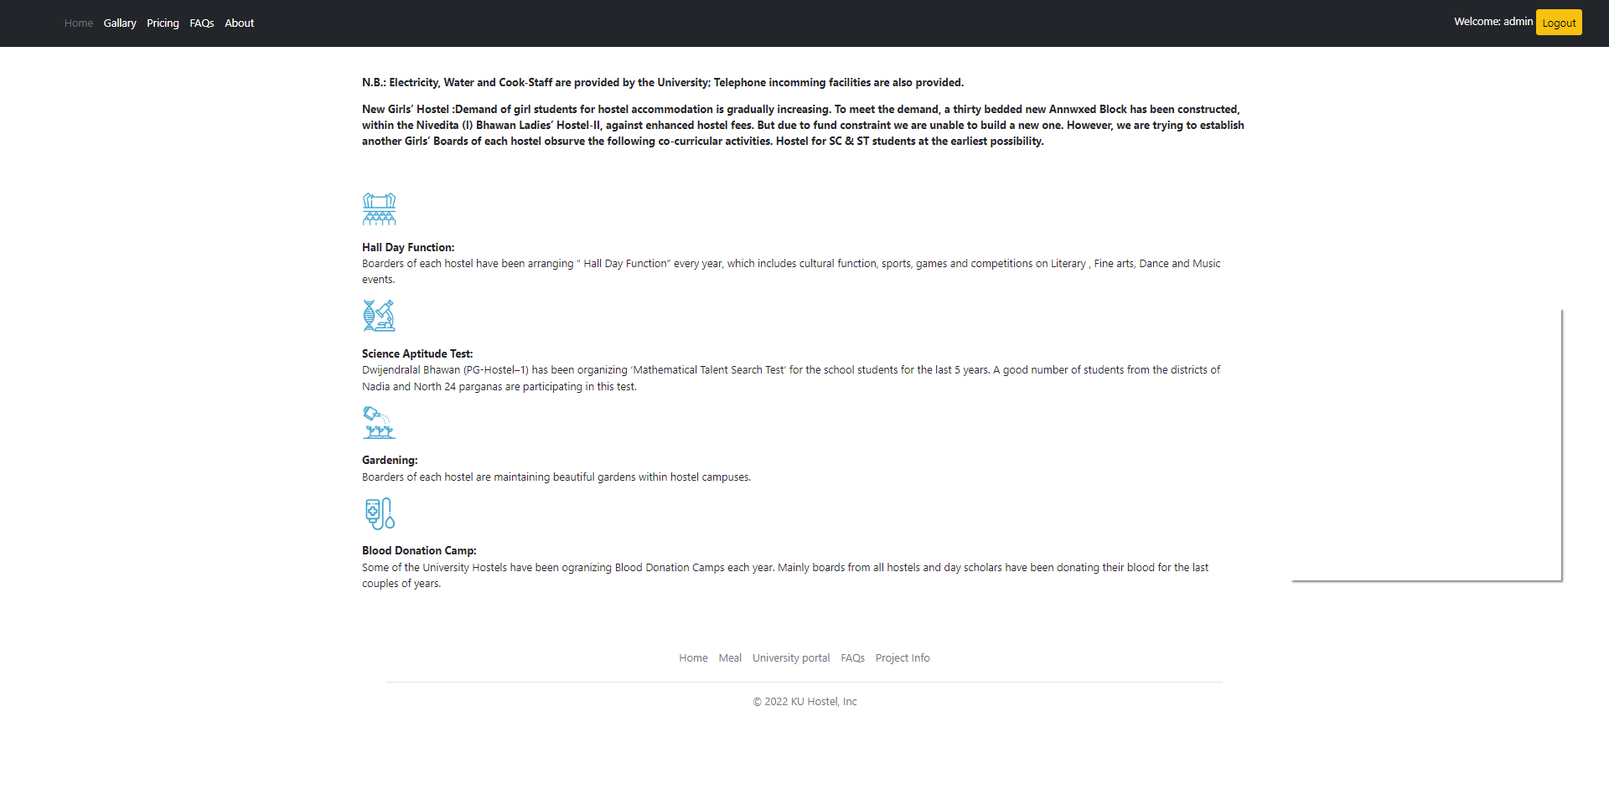
Front End

Slide 22
BACK END

Slide 23
Module Description
Admin Module:
In administrator module admin manages the master data’s like server details and student details. Accept the application of the students, view the application forms, reject the fake applications, view the complaints and suggestions given by students, edit the notice board, manipulate from the database.
Student Module:
In student module they can submit their application form, change password, register themselves in the hostels, can check their monthly meal charges and other charges, view the notice board, pay their monthly charges.
Manager Module:
In Manager module, the manager can calculate the mess bill, accept the application, view and modify students meal status and also change the password.

Slide 24
Software Used
Operating System: Linux, Windows 7/ 8/ 10/11.
Any browser like Google chrome or Mozilla Firefox to surf the web.
AWS EC2 web service.
Django(Web Framework), Python, SQLlite3, Git & GitHub, HTML, CSS, Bootstarp4, Tailwind CSS.
Hardware Requirement
Operating System: Linux, Windows 7/ 8/ 10/11.
Any browser like Google chrome or Mozilla Firefox to surf the web.
Intel processor 2.0 GHz or above.
2 GB RAM or more.

Slide 25
Data Flow Diagram(DFD) of the system
Client Side
Django Template
Urls(Urls.py)
http
request
Forward request to appropriate view
App
Logic
View
Logic
Model
(model.py)
Read/Write data
View(View.py)
html response
(HTML)
Model
Django framework
Server Side
Template
<filename.html>
Database

Slide 26
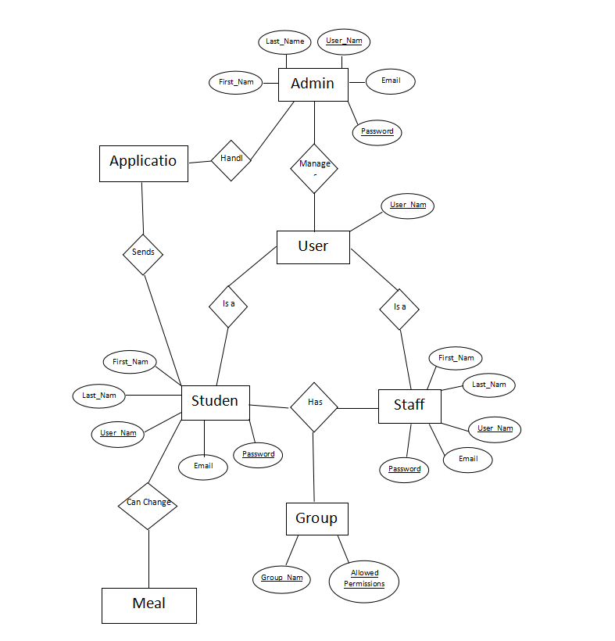
E-R Diagram

Slide 27
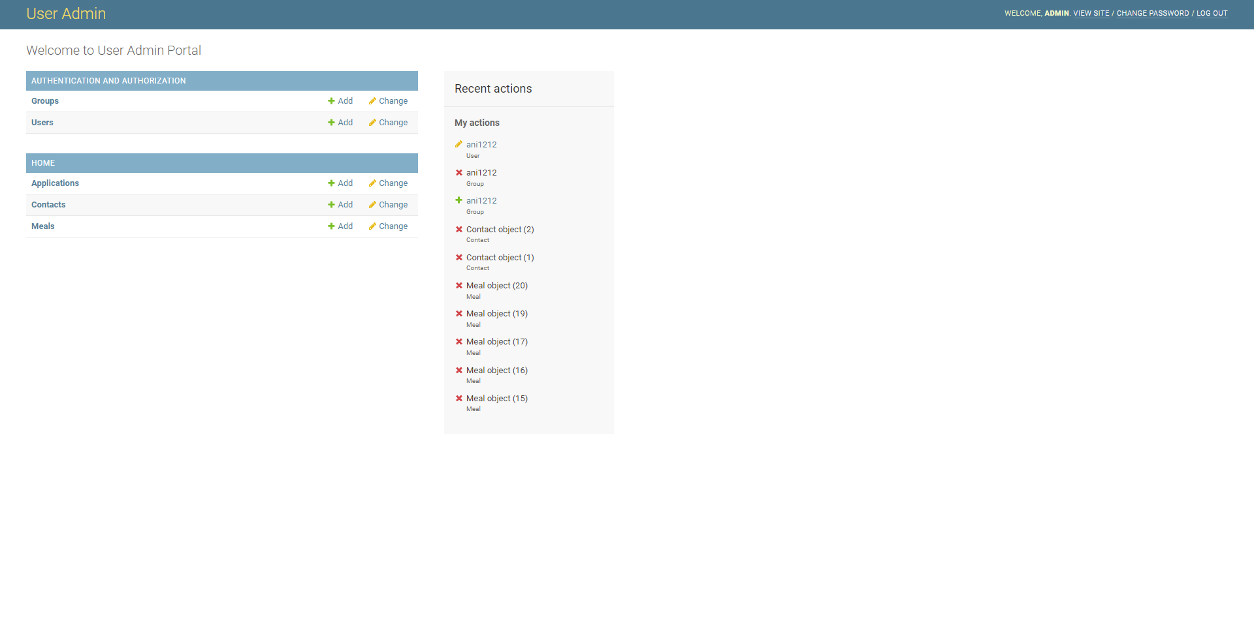
Back End (Admin)

Slide 28
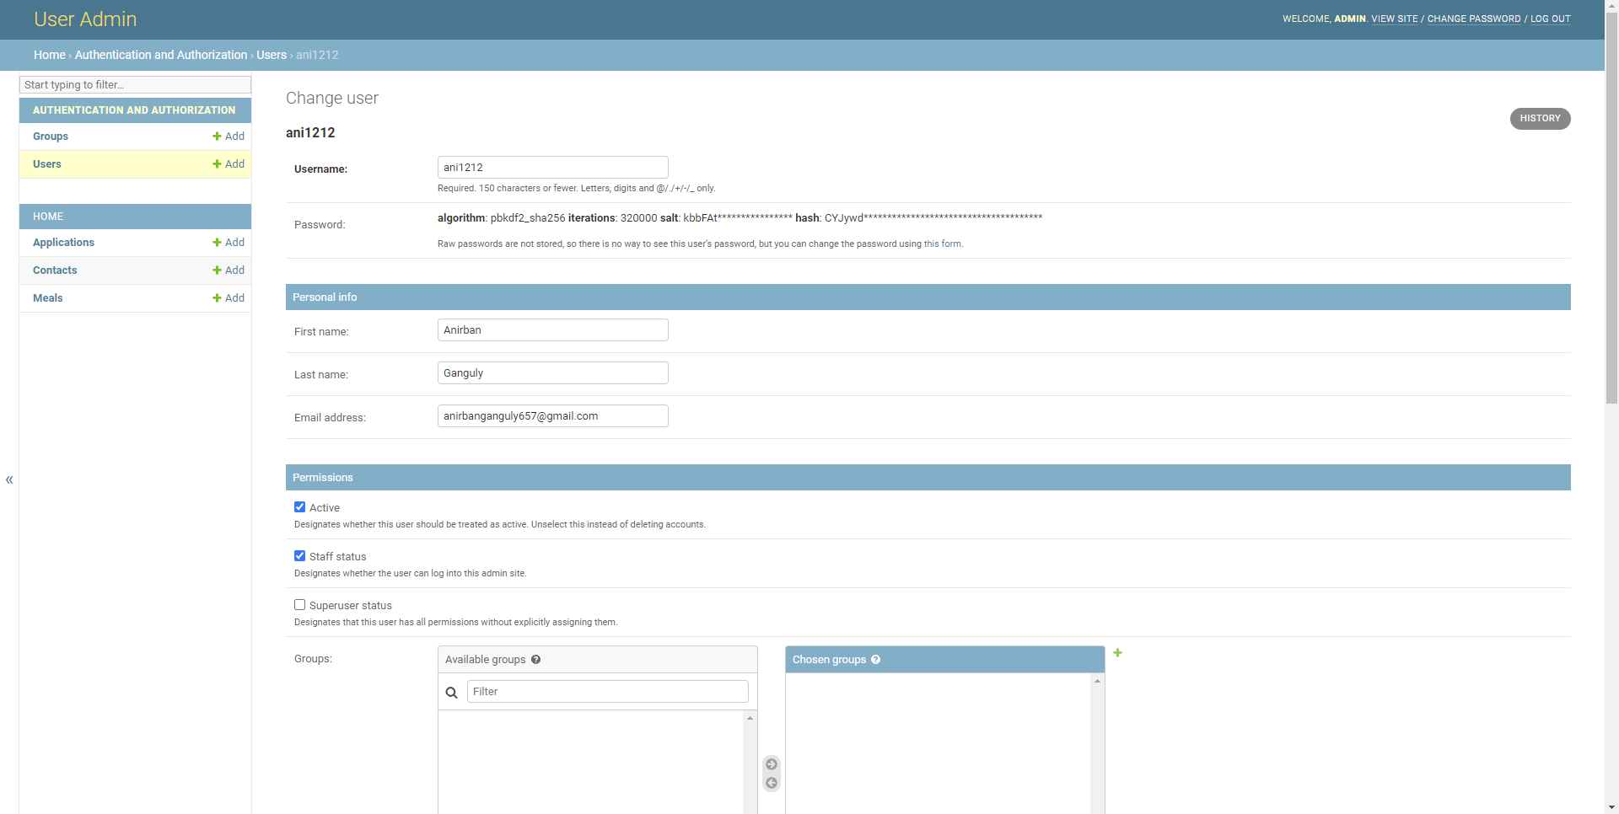
Back End (Admin-Users)

Slide 29
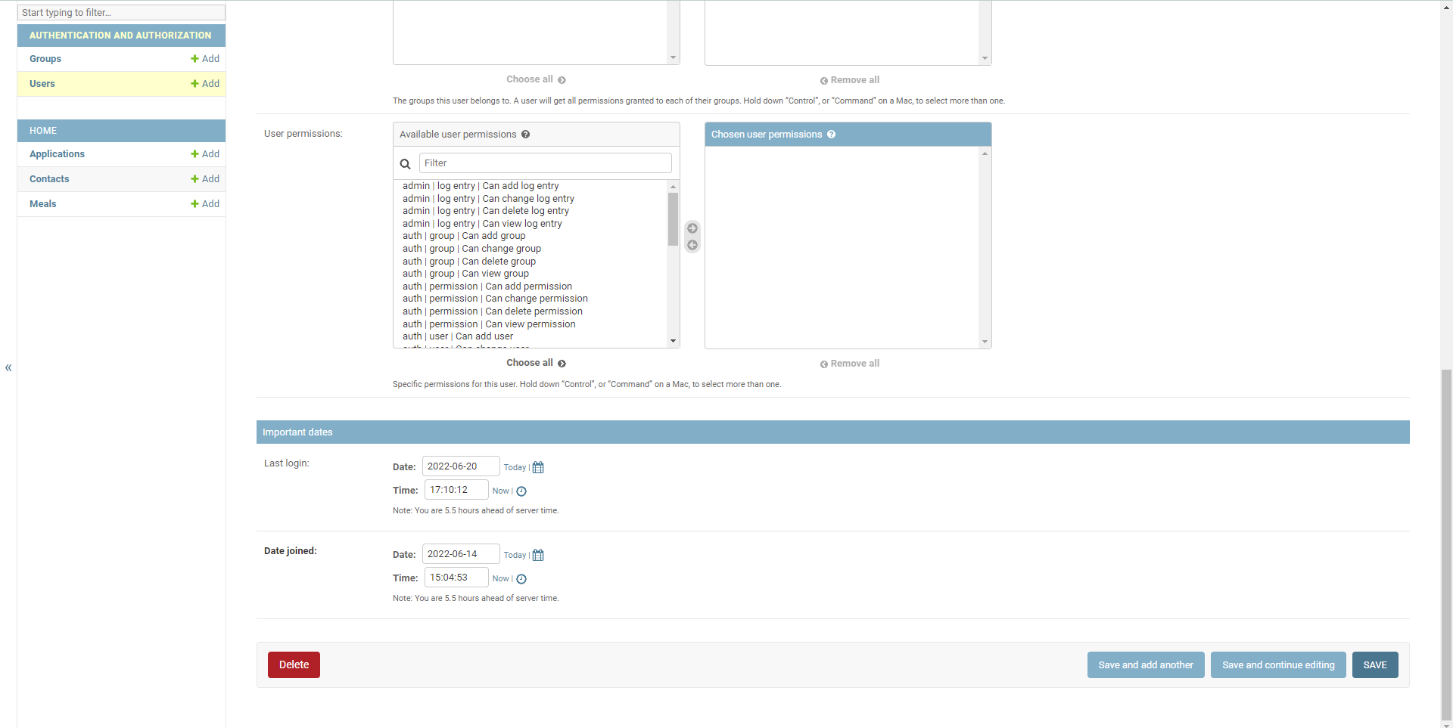
Back End (Admin-Users)

Slide 30
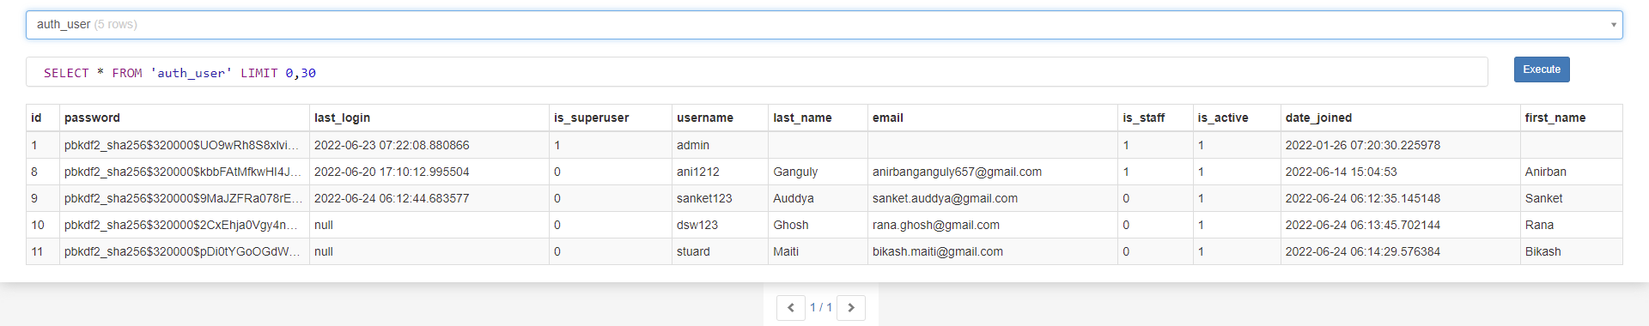
Back End (User Data)

Slide 31
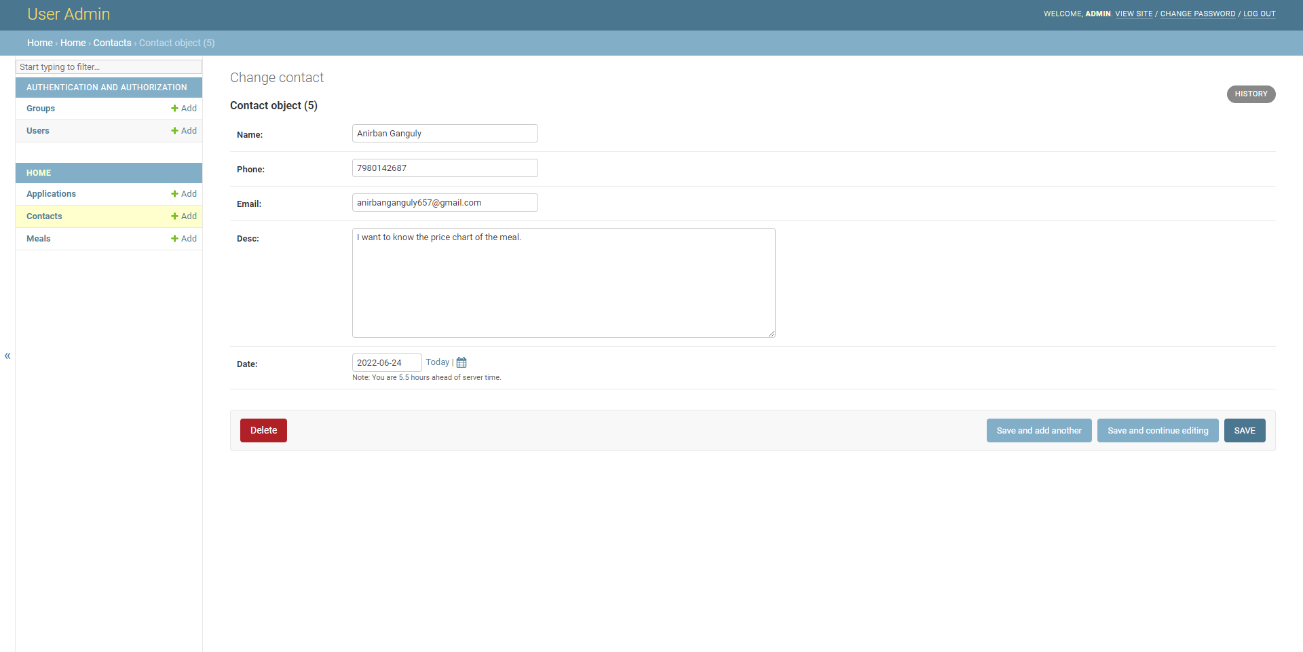
Back End (Admin-FAQ)

Slide 32
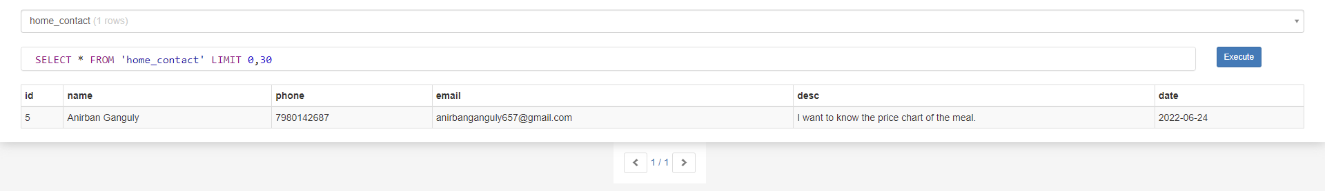
Back End (FAQ-Data)

Slide 33
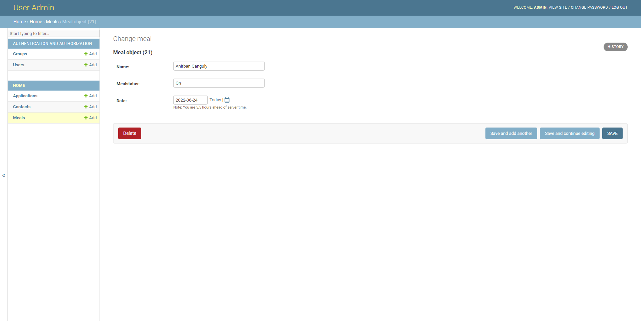
Back End (Admin-Meal)

Slide 34
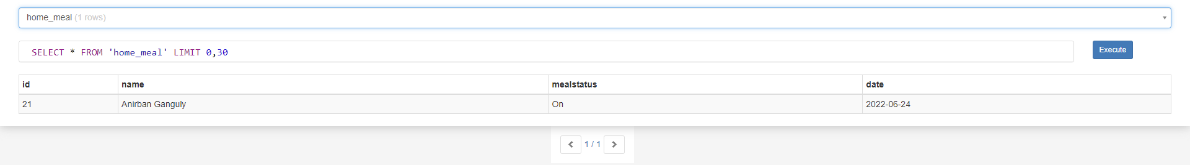
Back End (Meal data)

Slide 35
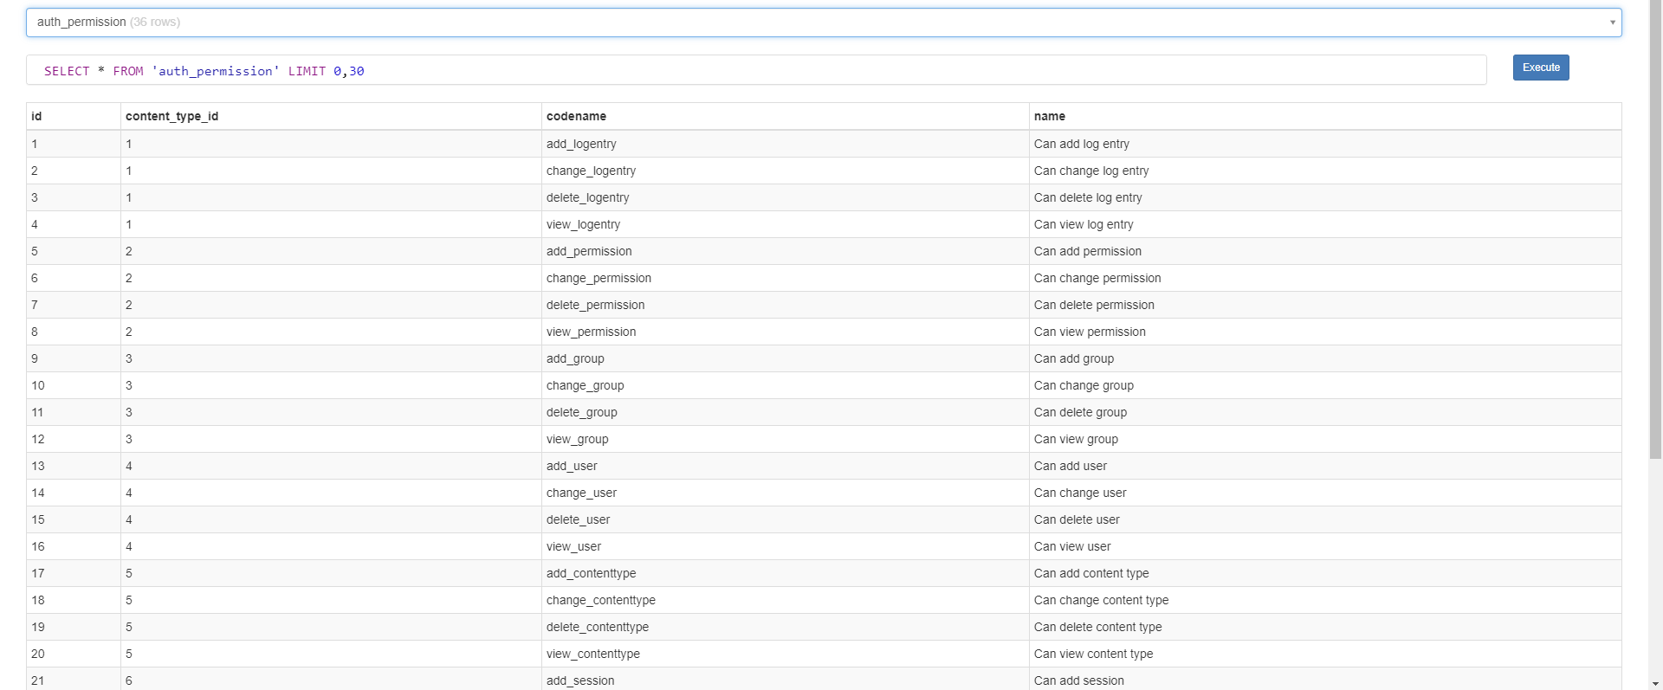
Back End (Permission)

Slide 36
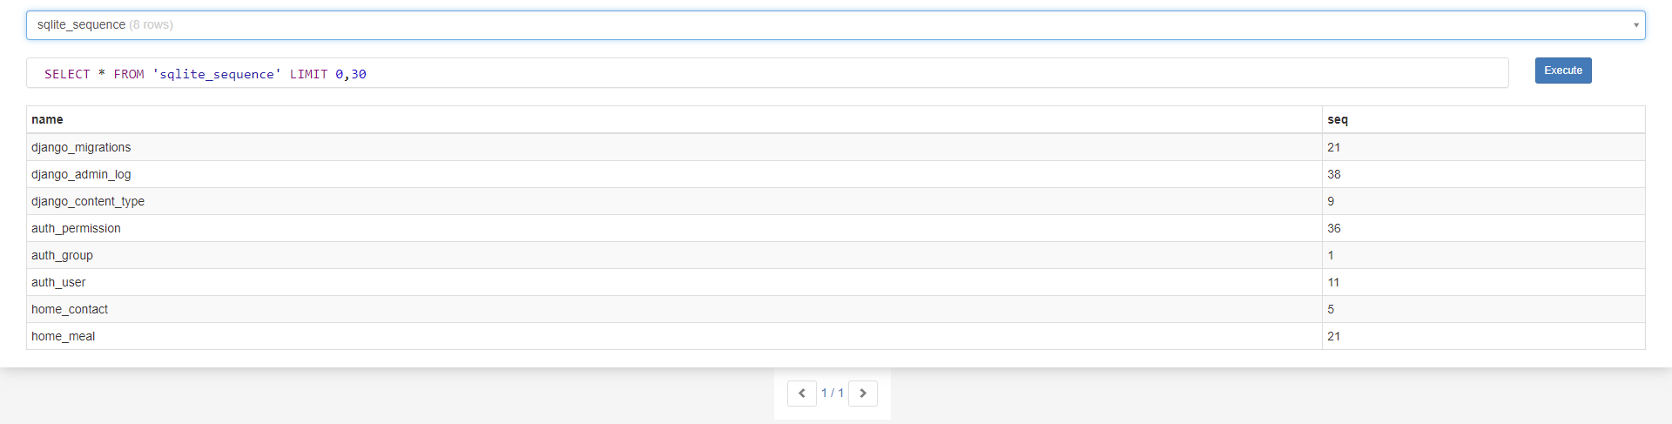
Back End (Logs)

Slide 37
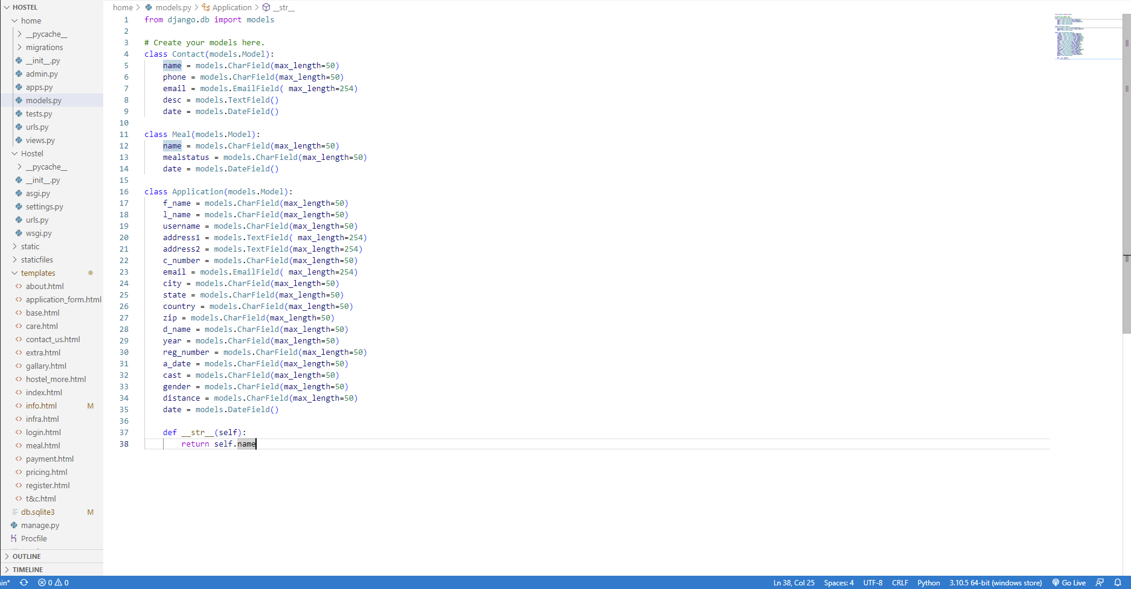
Back End (Models)

Slide 38
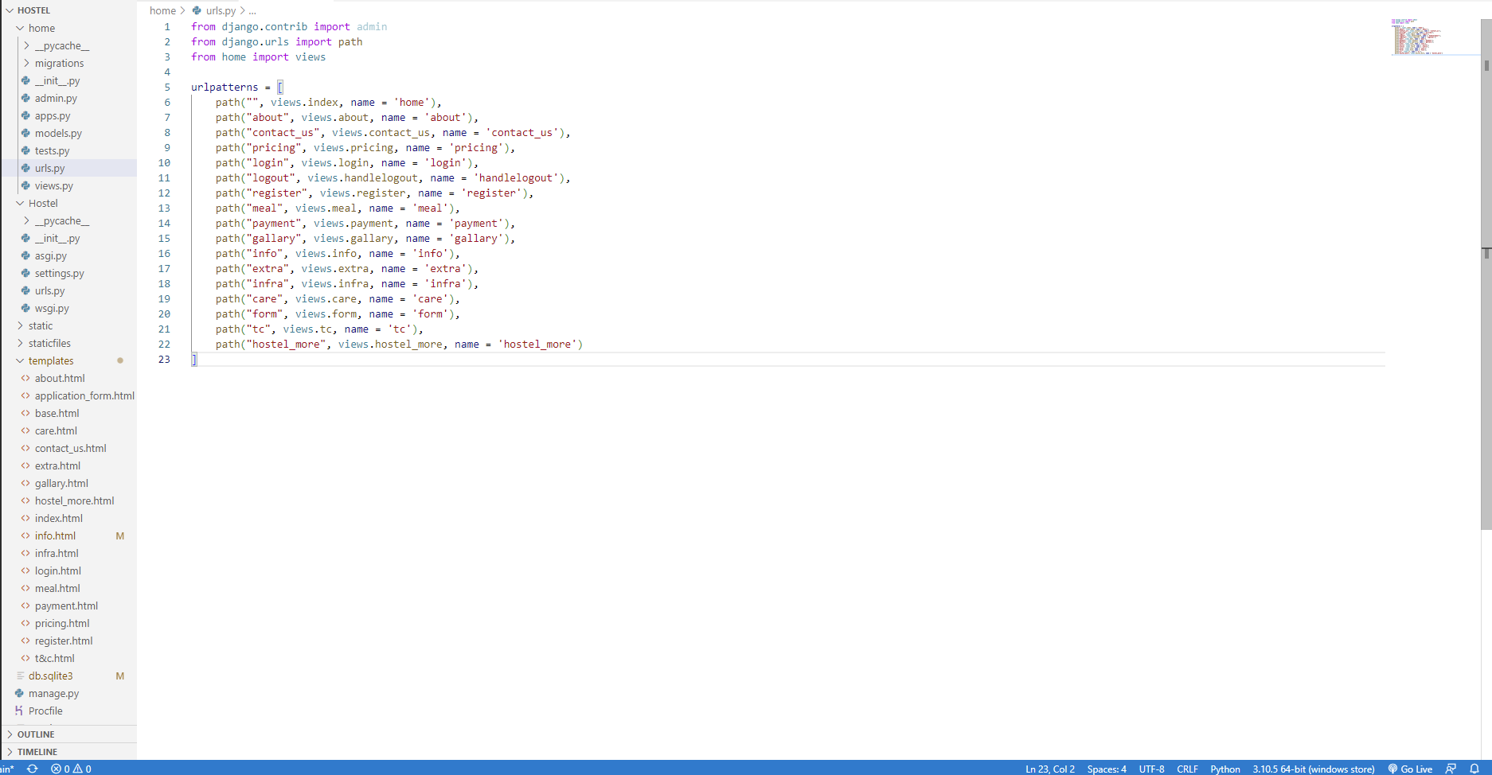
Back End (URLs)

Slide 39
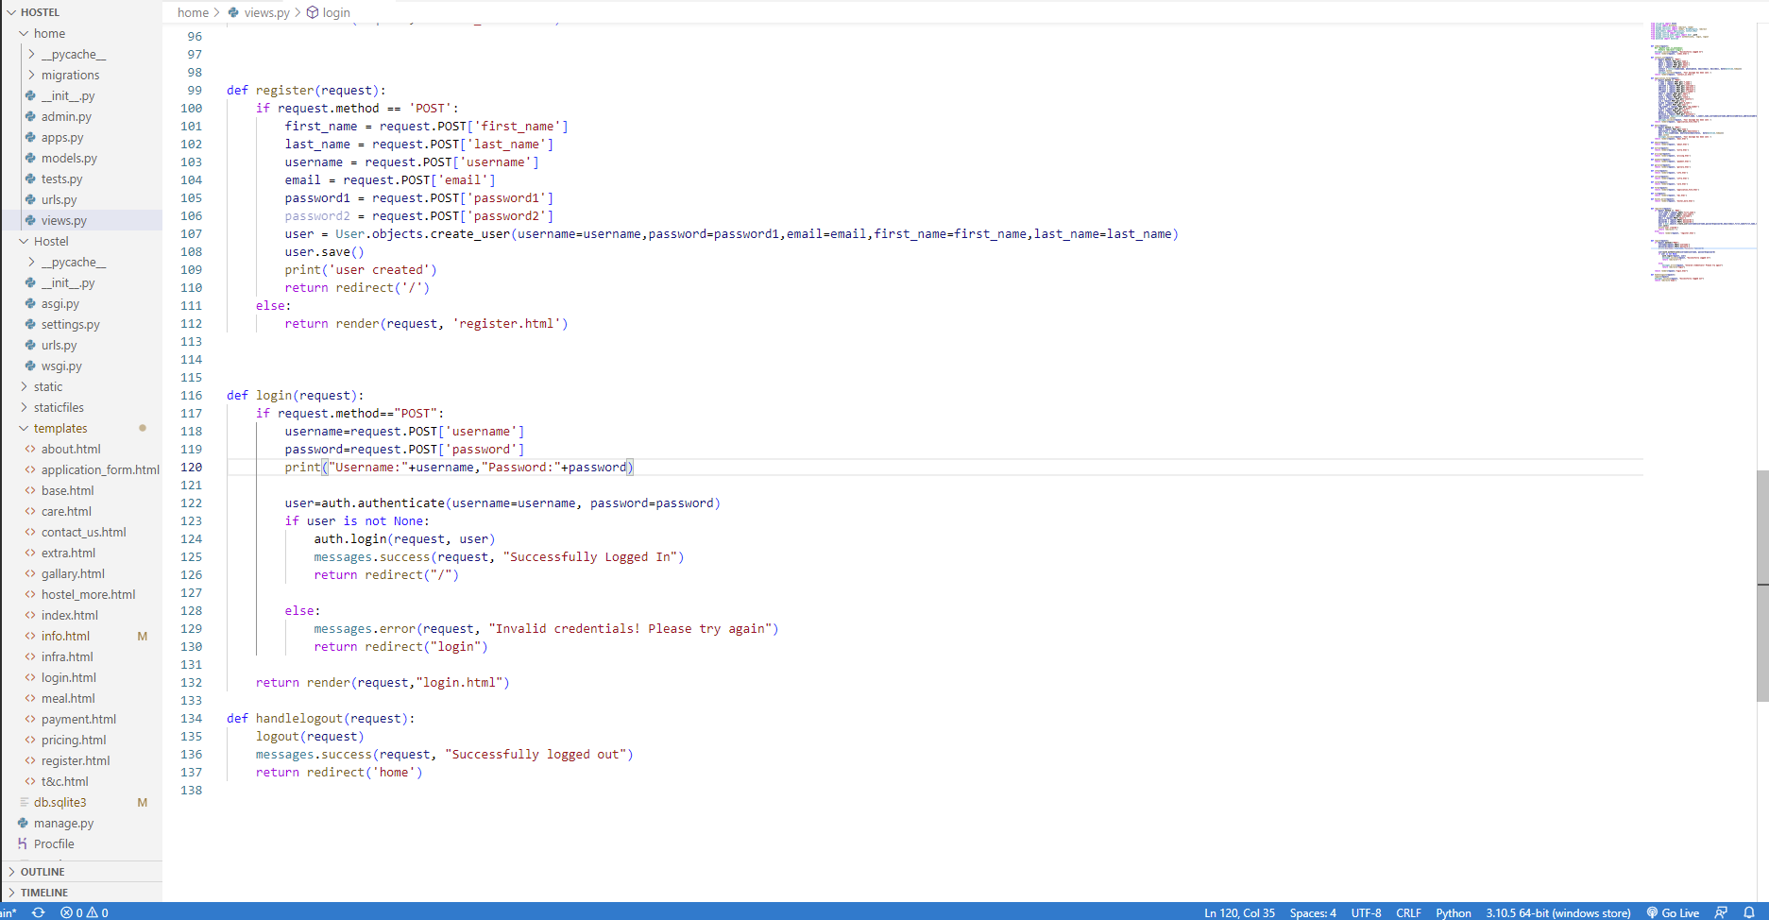
Back End (Views)

Slide 40
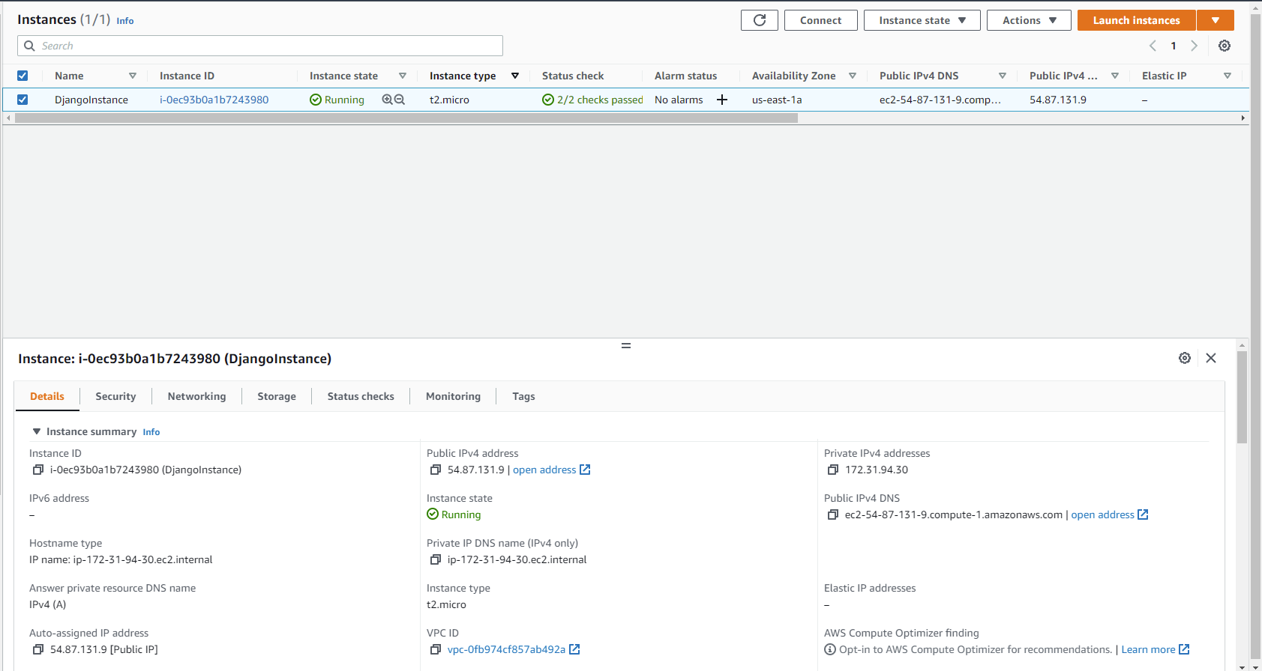
Back End (AWS)

Slide 41
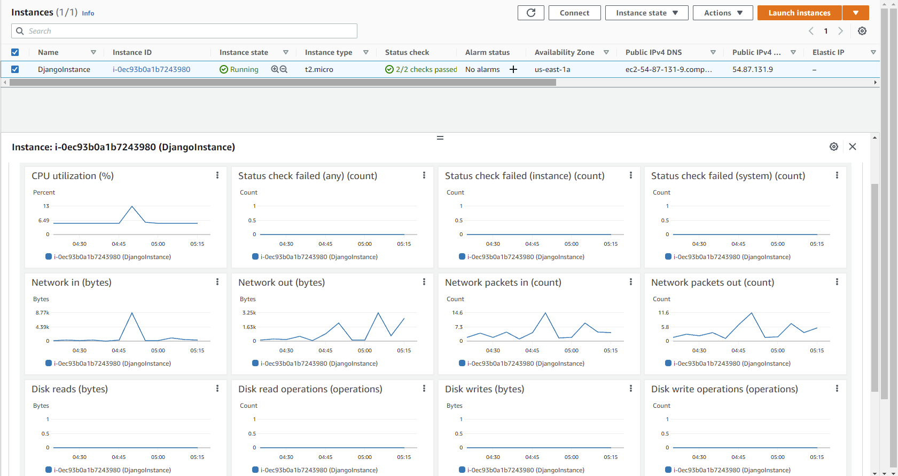
Back End (AWS-Monitors)

Slide 42


